Slide 1

Using CNNs to Predict Future Terror Attack Locations
Liam Smith - MSDS 2024

Slide 2
Agenda
Background on data and project
Exploration of data and correlations
Prediction and application of findings

Slide 3


Background-Global Terrorism Database
Created and Maintained out of a University of Maryland research lab the GTD houses information on a large amount of the world’s terrorist attacks
Database includes attacks going all the way back from 1970 to 2021

Slide 4
Background- GTD Dataset
Location (specific and country based)
Text summary
Weapons utilized
Casualties
“Success” and more
Terrorist group
Contains information on 181.7 thousand unique terrorist attacks
Over 3100 of which occurred in the United States
Information provided includes

Slide 5
Background additional Datasets
Unemployment
Arms Import (worldwide)
Firearms licenses
Executive Branch Budget
Immigration
Political Polarization
Crime
Combined datasets from multiple different sources to better understand their impact on terrorism
Ended with a total of 185 columns in the dataset

Slide 6
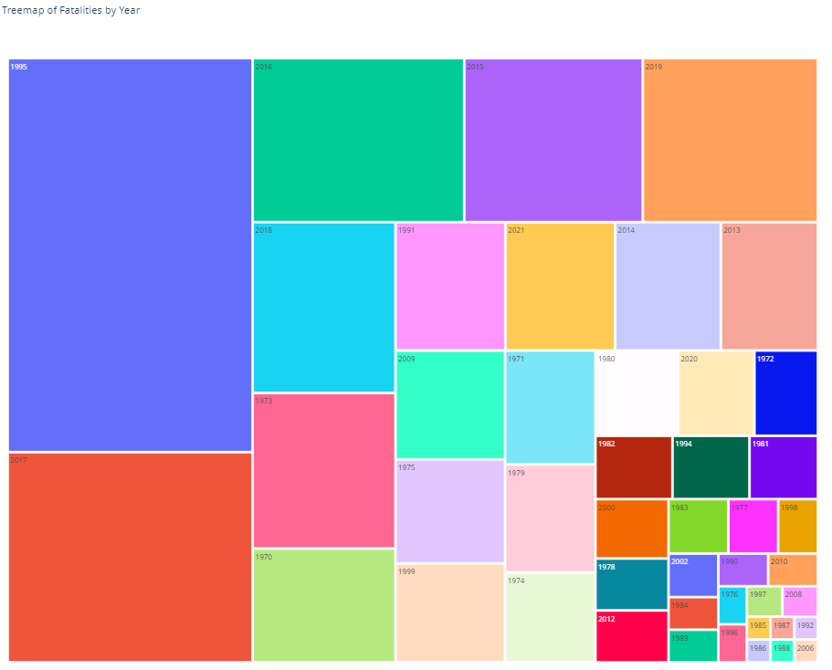
data Exploration
Deaths over the years

Slide 7
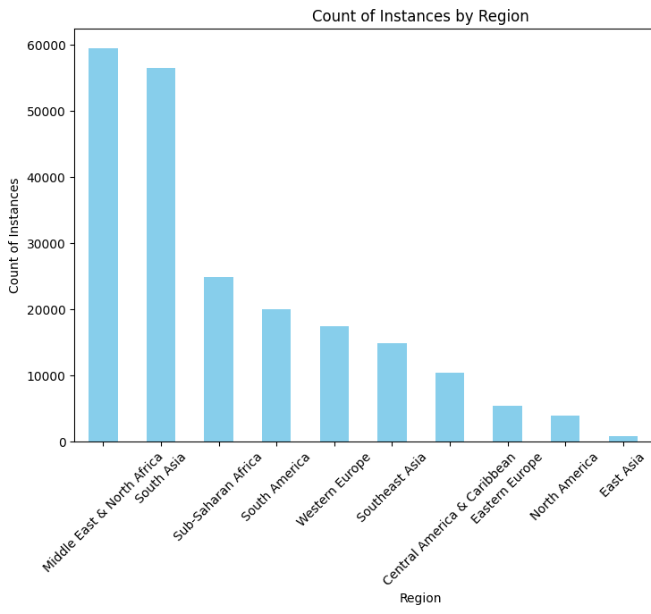
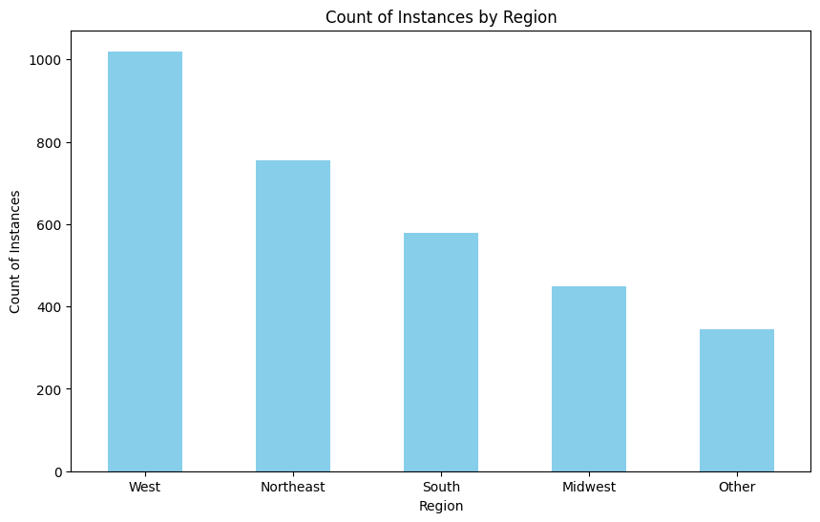
data Exploration
Global and US Regional Attacks

Slide 8
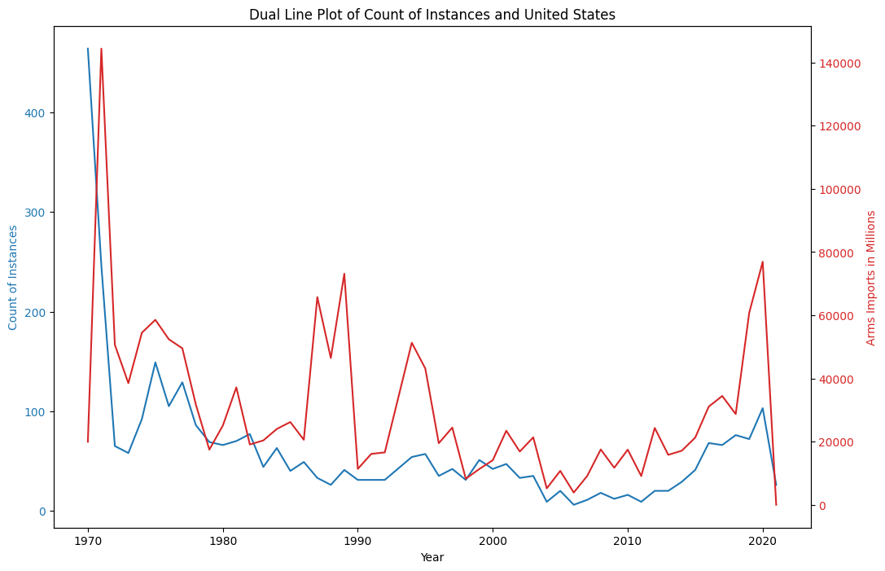
data Exploration
Arms Imports

Slide 9
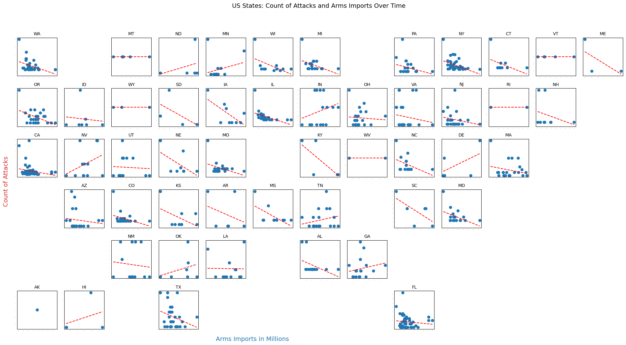

Slide 10

Predictions- Model Type
I utilized a deep learning technique called Convolutional Neural Networks or CNN for short
The specific type of CNN used was a GAN model which in a sense builds two competing models the generator and the discriminator
One creates fake images to fool the other model, when the generator fails it is notified by the discriminator and tries again
This continues happening until ideally the generator can successfully fool the discriminator on a consistent basis
When this happens the model is capable of creating new/fake images, no matter what the image may be

Slide 11
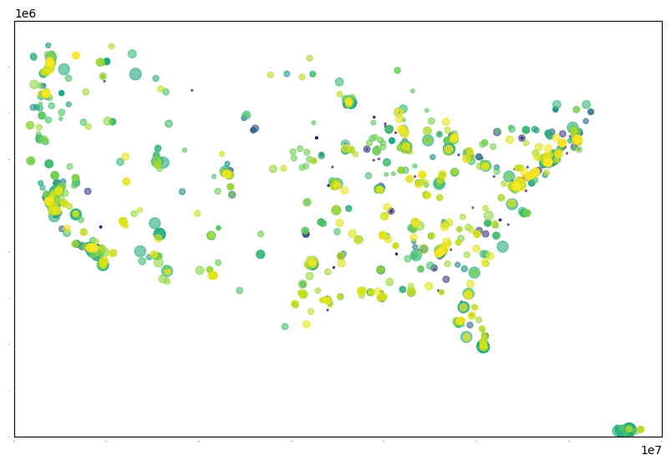
Predictions- My Model
In this case the images fed to the model are longitude and latitude maps of the terror attacks taking place in the US monthly
The model is trained on maps based on attacks that occurred from 1970 to 2015 in the US (462 maps)
It is evaluated on data from 2016 to 2021 (66 maps)
This is the layout of the images the model is seeing but instead of all at once it must read monthly images

Slide 12



Predictions- Ability/Evaluation
This is an intensive and powerful model, and images are hard to create
The original design of the model took 48 minutes to complete runtime
When tuned to create the most accurate images the model was able to complete within 21 hours
Because it is just an image the model is difficult to evaluate, there are no numbers to compare, just dots on a map

Slide 13

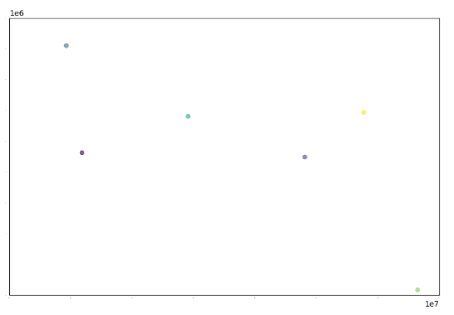
Predictions- Evaluation
When looking specifically at the images outputted, we can see something exciting
The “fake” image produced by the model when compared to a real image of terror attacks shows impressive correlation
Pay close attention to the circled areas in which the model “predicted” a terror attack which occurred

Slide 14
21 Hour and Current Model, loss and accuracy

Slide 15



Predictions- Application
This sort of model has incredible civil, law enforcement, and defense capabilities
Besides its obvious ability to predict and therefore help prevent future attacks
The data can be used to show some odd correlations between terrorism and previously unrelated data
In practice it could be used to reduce even the likelihood of a terrorist attack
Overall this model is far from perfect but is clearly capable of doing some amazing things, which I plan on seeing through to its fullest potential

Slide 16
Thank You
Please contact me at (401) 787-8328 or lsmith9411@outlook.com with any questions

Slide 17

2100

Slide 18
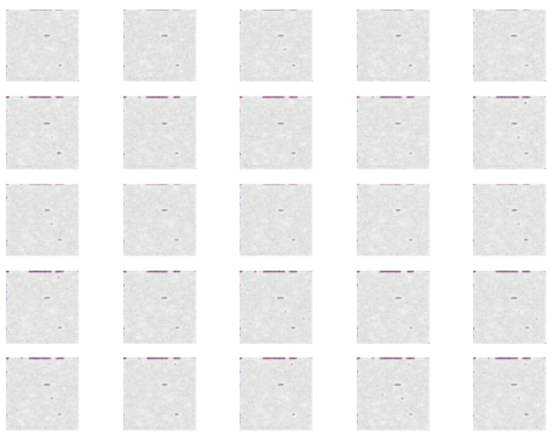
1050

